Slide 1
UNIT I INTRODUCTION TO ALGORITM DESIGN
Session – 7

Slide 2
Recurrence relation - recursion
solving recurrences
expanding the recurrence into a tree
summing the cost at each level

Slide 3
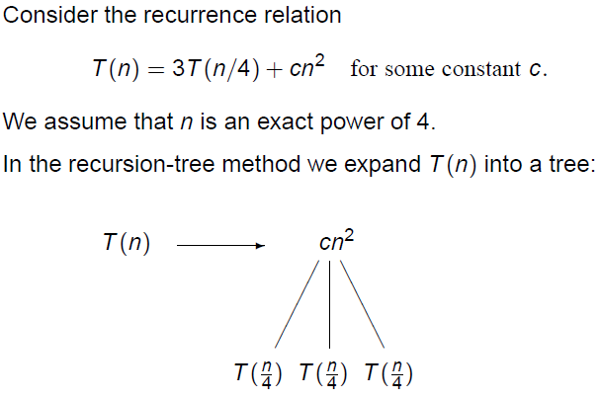
Example

Slide 4
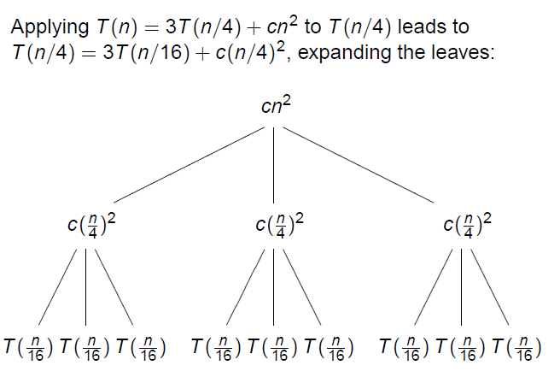
Expand T(n/4)

Slide 5
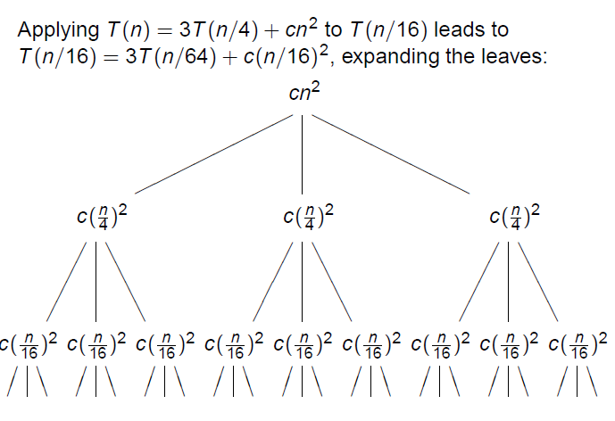
Expand T(n/16)

Slide 6
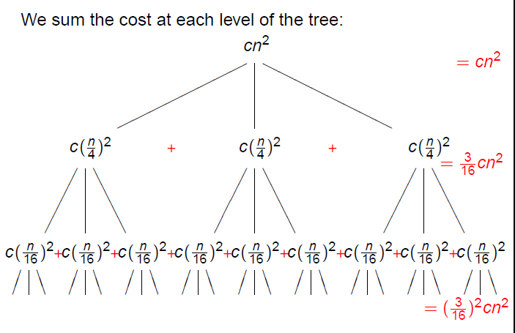
Summing the cost at each level

Slide 7
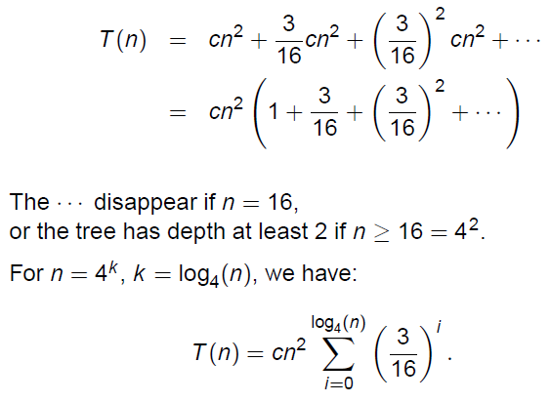
Adding up the costs

Slide 8
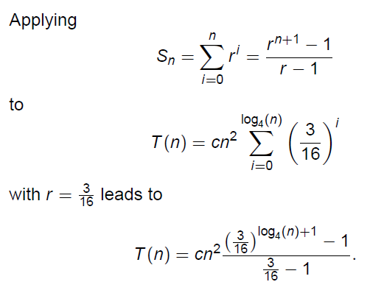
Applying the geometric sum

Slide 9
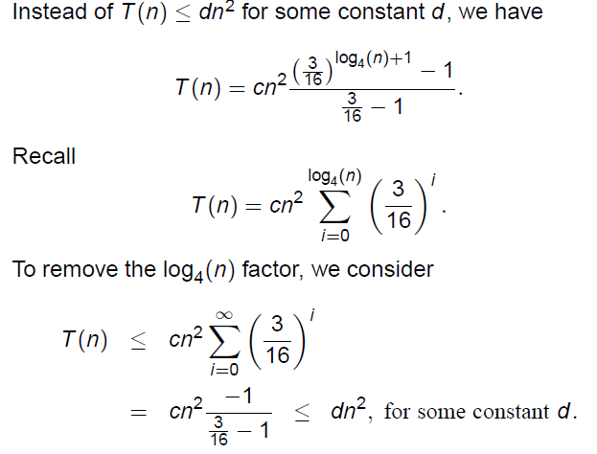
Polishing the result we get

Slide 10
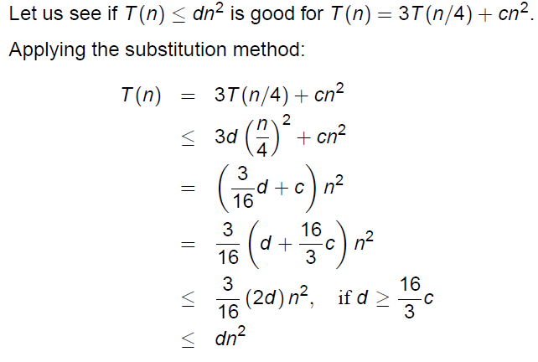
Verify the guess by applying substitution method

Slide 11
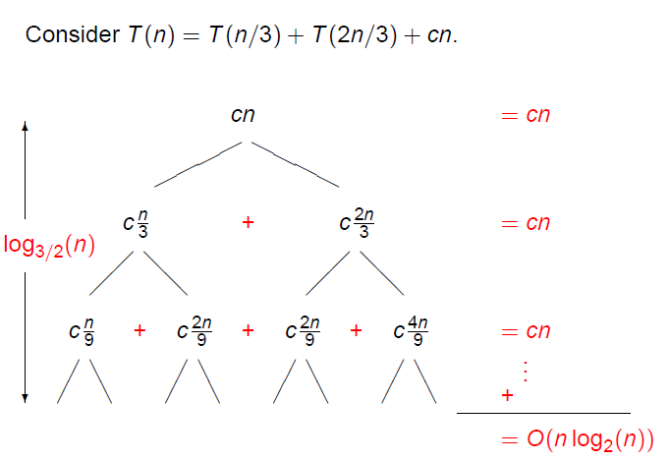
Lets see another example

Slide 12
Lets practice
Consider T(n) = 3T(n/2) + n. Use a recursion tree to derive a guess for an asymptotic upper bound for T(n) and verify the guess with the substitution method.
T(n) = T(n/2) + n².
T(n) = 2T(n − 1) + 1.

Slide 13
Worksheet No. 7

